Slide 2
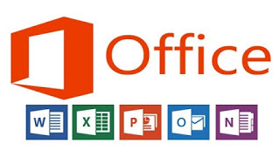
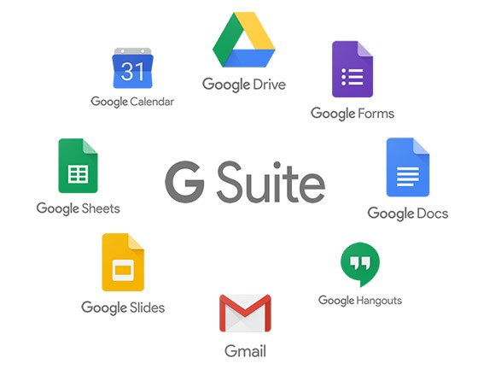
Cloud Services – Software as a Service (SaaS)
Applications provided on cloud infrastructure
Notes:
https://azure.microsoft.com/en-us/solutions/
https://aws.amazon.com/
https://cloud.google.com/
https://www.nist.gov/publications/nist-cloud-computing-reference-architecture
Special Publication (NIST SP) - 500-292

Slide 3

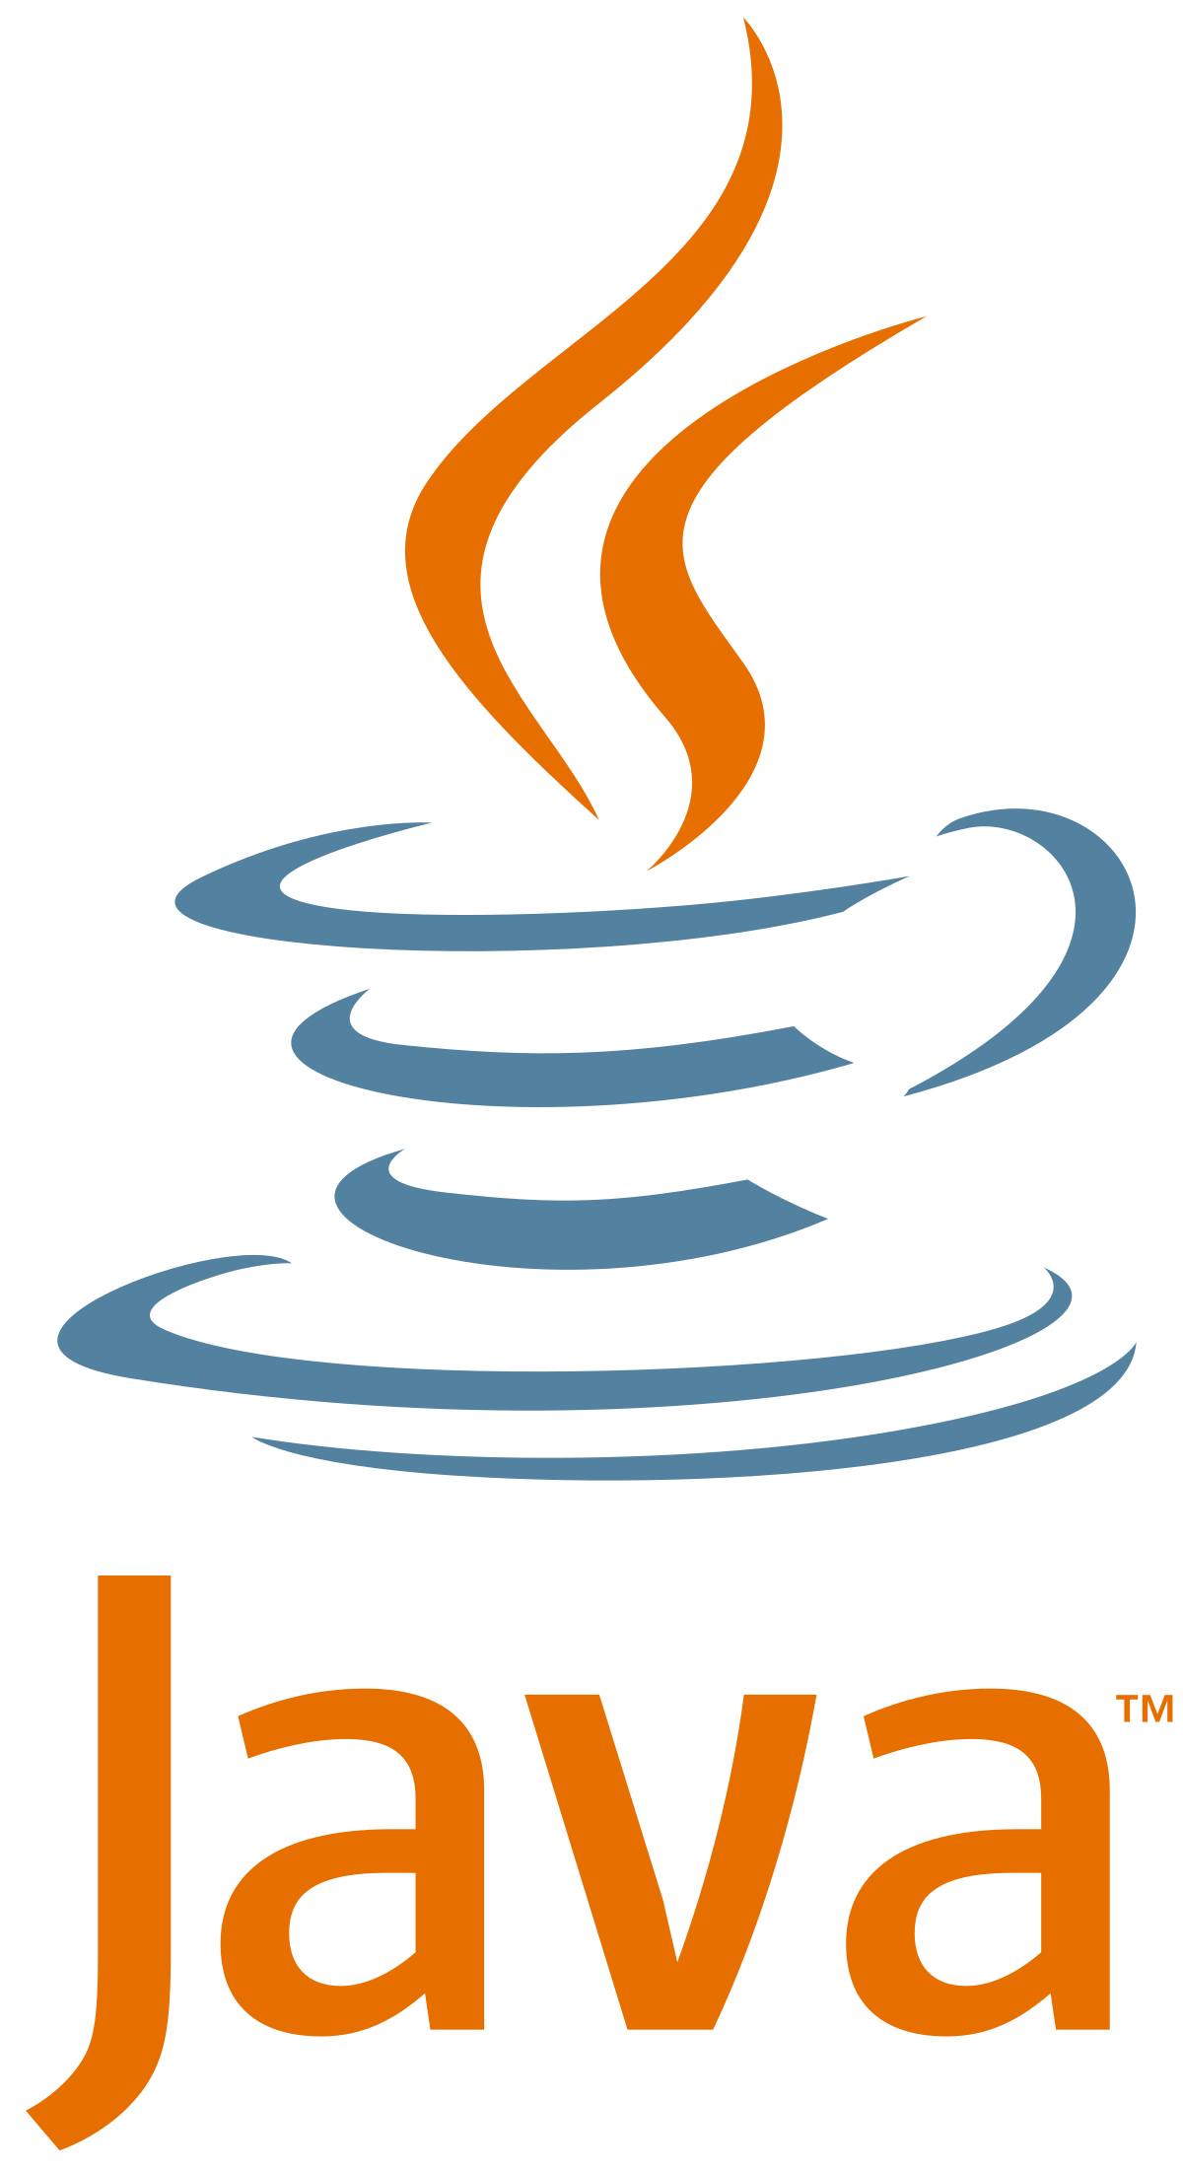
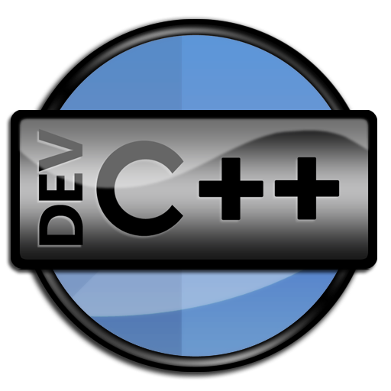

Cloud Services – Platform as a Service (PaaS)
Runtime environment provided on cloud infrastructure
Notes:
The capability provided to the consumer is to deploy onto the cloud infrastructure consumer-created or acquired applications created using programming
No need to manage hardware or operating systems
This allows us customers to perform dev without needing to worry about the underlying servers (serverless computing)
Taking this a step further we can break down/ separate and application into its individual pieces or services (microservices) each running an individual process
https://azure.microsoft.com/en-us/solutions/
https://aws.amazon.com/
https://cloud.google.com/

Slide 4


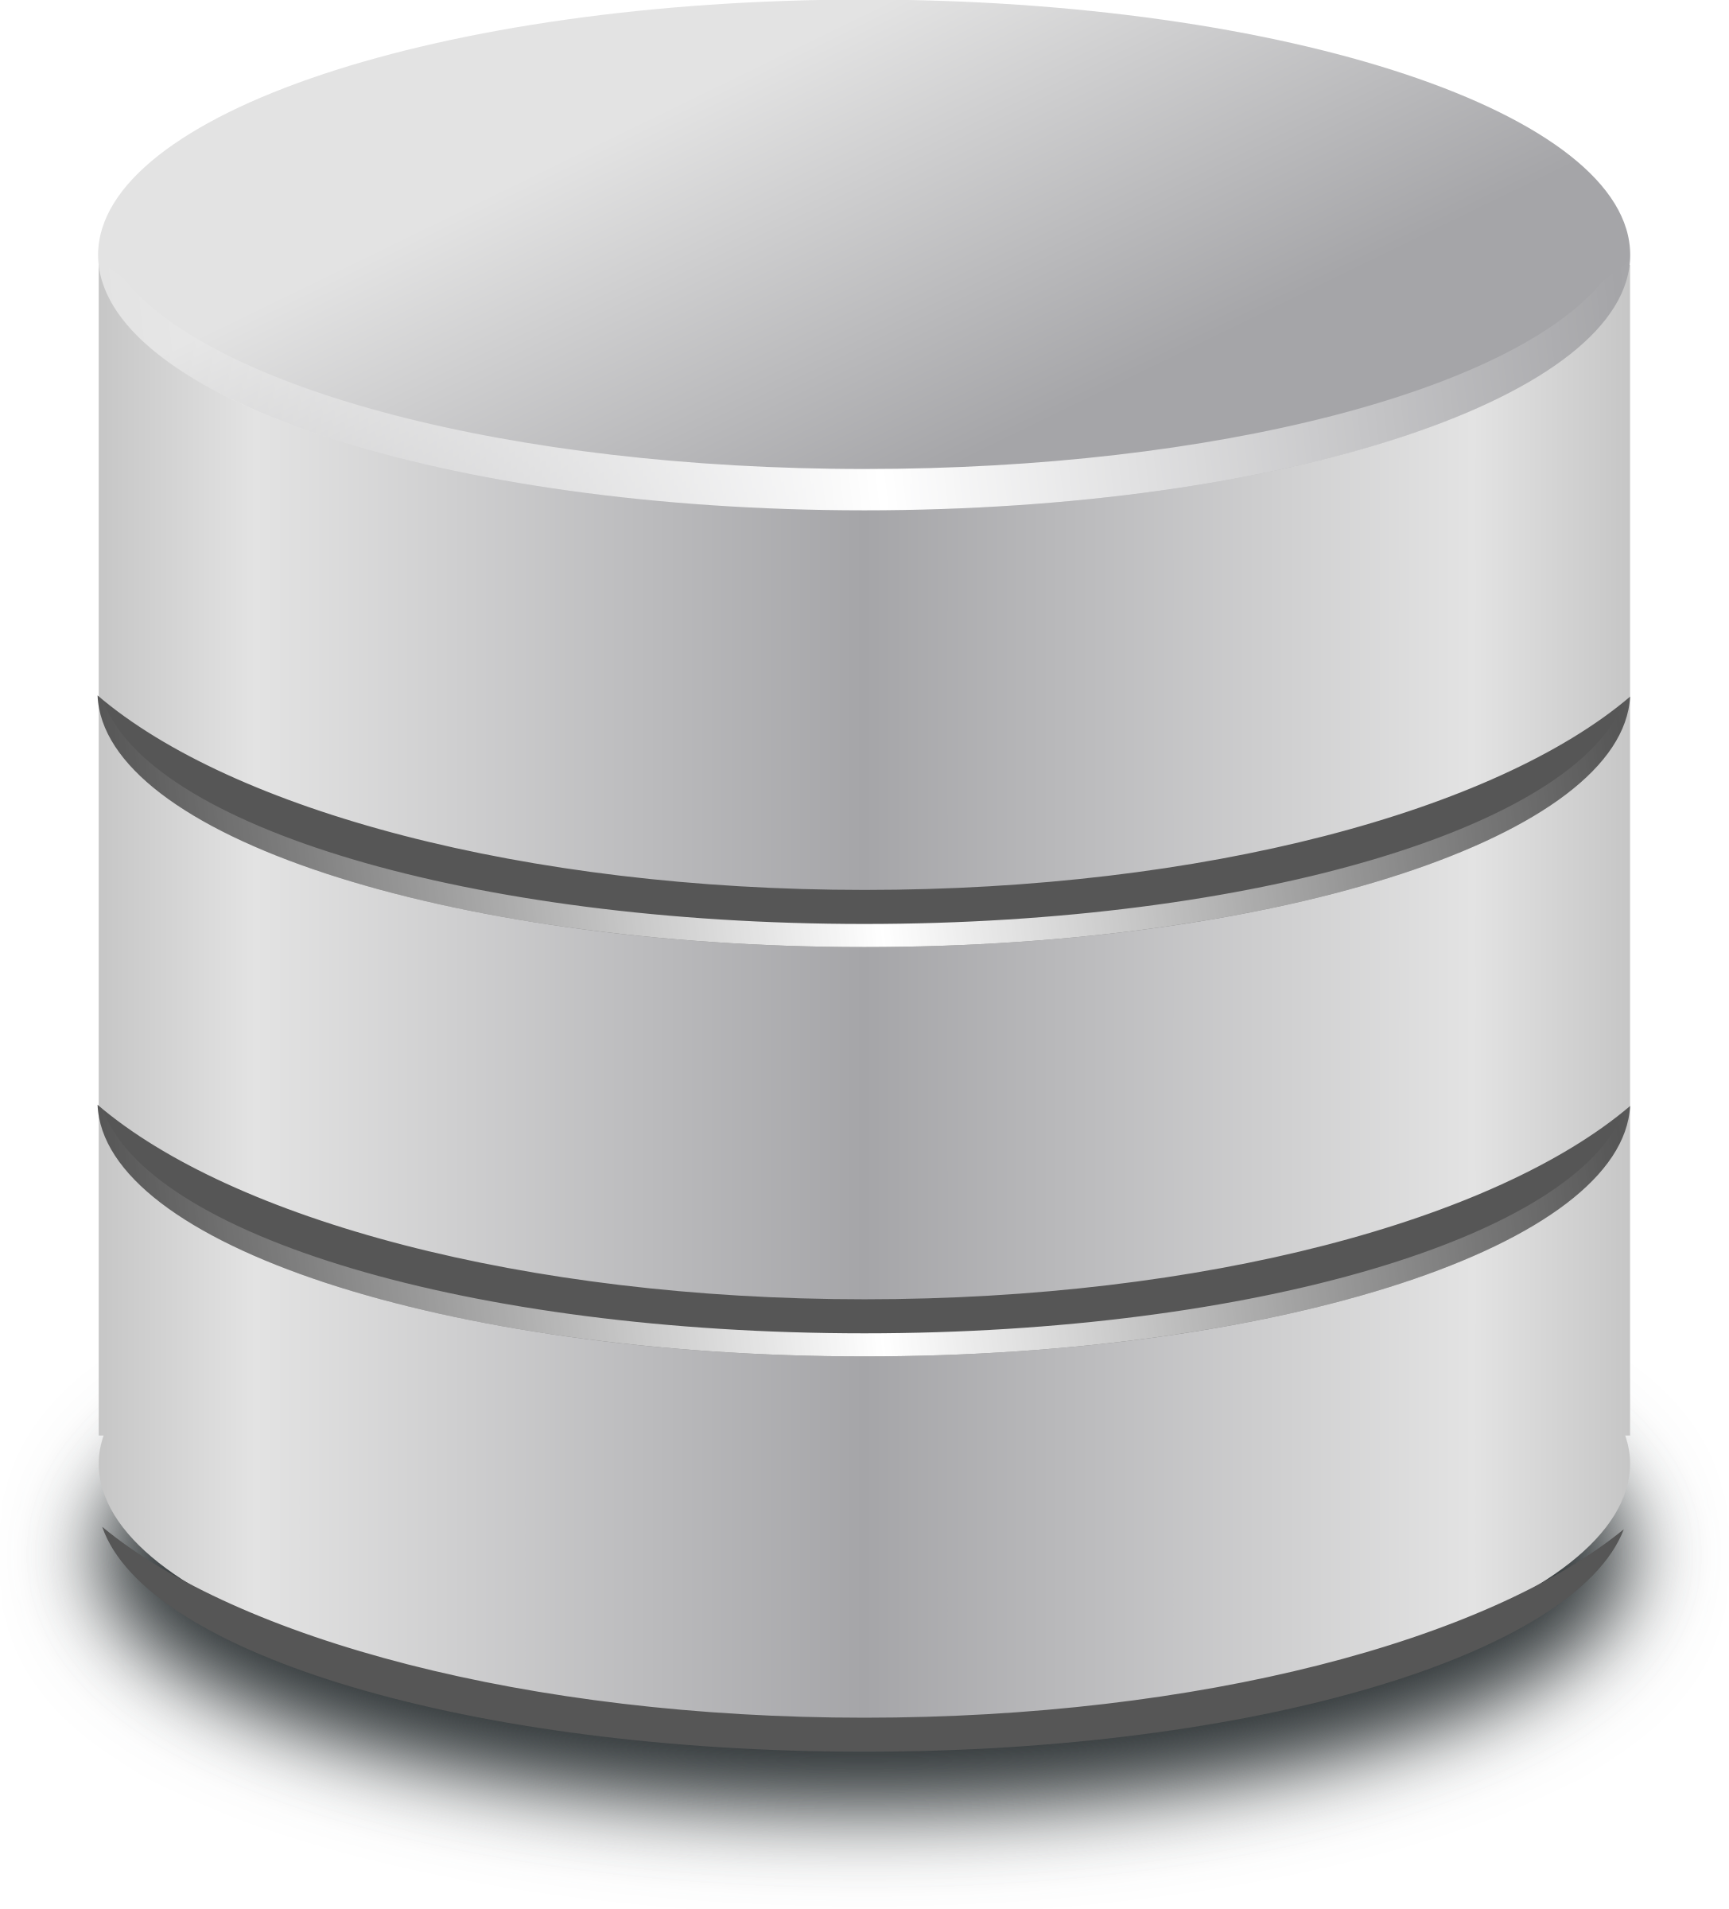
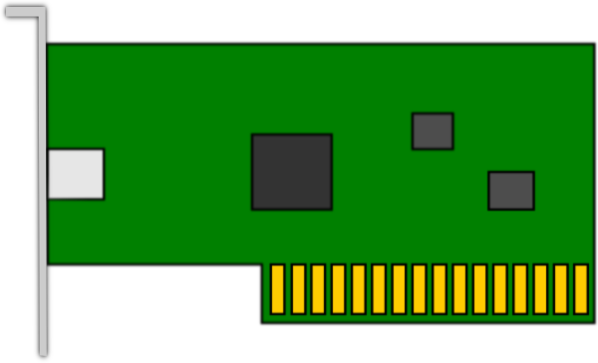
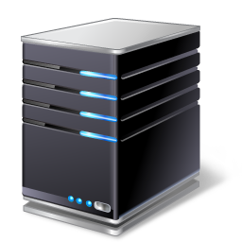
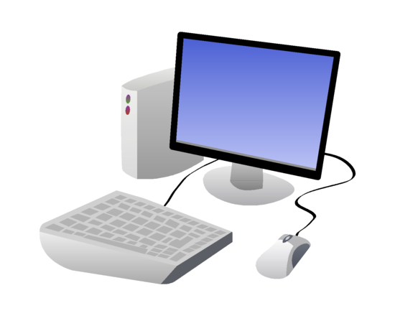

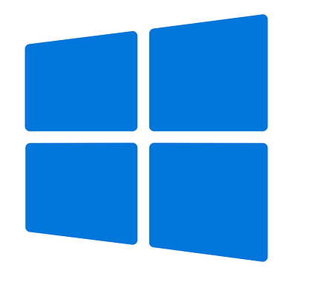
Cloud Services – Infrastructure as a Service (IaaS)
Organization providing cloud computing services
This Photo by Unknown Author is licensed under CC BY-SA
Notes:
The capability provided to the consumer is to provision processing, storage, networks, and other fundamental computing resources where the consumer is able to deploy and run arbitrary software
https://azure.microsoft.com/en-us/solutions/
https://aws.amazon.com/
https://cloud.google.com/

Slide 5
Cloud Services – Anything as a Service (XaaS)
Every and any service provided on cloud infrastructure
CaaS/CaaS
STaaS
DaaS
SECaaS
DBaaS
Notes:
CaaS = Containers as a Service
CaaS = Code as a Service
STaaS = Storage as a Service
DaaS = Desktop as a Service (WaaS = Windows as a Service)
SECaaS = Security as a Service
DBaaS = Database as a Service
XaaS encompasses any computing service that is delivered via the internet and paid for in a flexible consumption model rather than as an upfront purchase or license.

Slide 6
Management Responsibilities
On-Premise
Application
Data
Runtime
Middleware
Operating System
Virtualization
Servers
Storage
Networking
IaaS
Application
Data
Runtime
Middleware
Operating System
Virtualization
Servers
Storage
Networking
PaaS
Application
Data
Runtime
Middleware
Operating System
Virtualization
Servers
Storage
Networking
SaaS
Application
Data
Runtime
Middleware
Operating System
Virtualization
Servers
Storage
Networking
Customer
Provider

